Slide 1

Analyzing the Impact of Social Media Usage on Productivity
Bilge Kağan Yılmaz
30895

Slide 2
Motivation, Hypothesis & Data Sources
Hypothesis: Increased screen time negatively impacts focus time.
Objective: Explore the relationship between TikTok screen time and productivity.
TikTok Screen Time Data: Daily total screen time, day/night usage.
Forest App Data: Daily focus time, focus sessions.

Slide 3
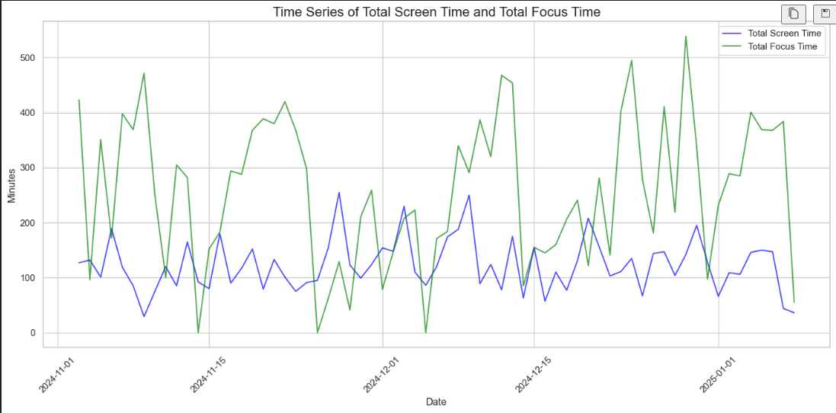
Time Series Analysis
Observed trends between screen time and focus time.

Slide 4
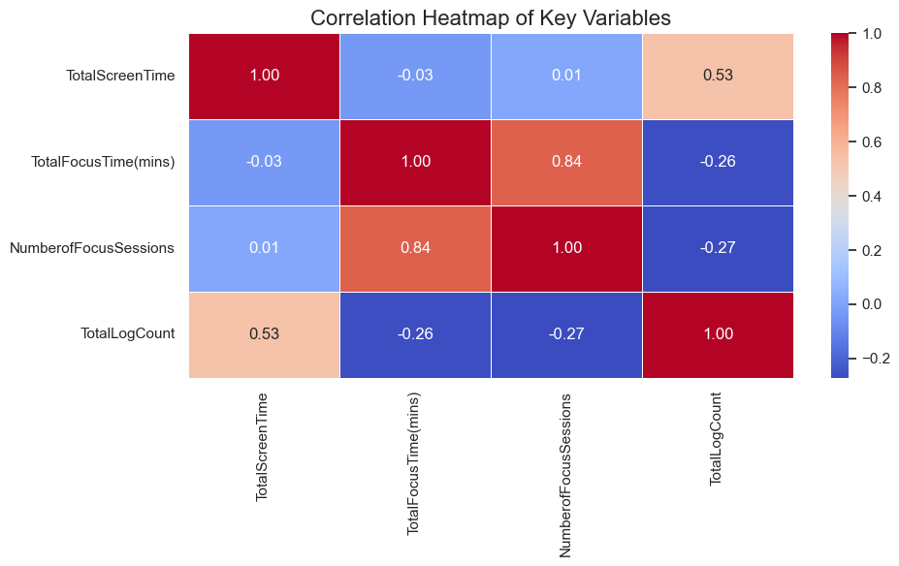
Correlation Heatmap
Highlights weak correlation between screen time and focus time.

Slide 5
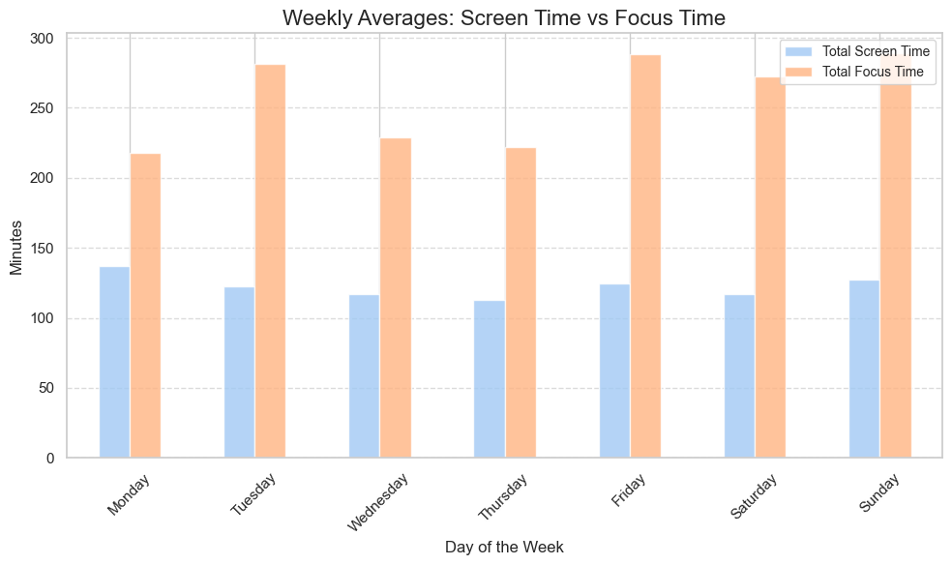
Weekly Correlation Between Screen Time and Focus Time

Slide 6
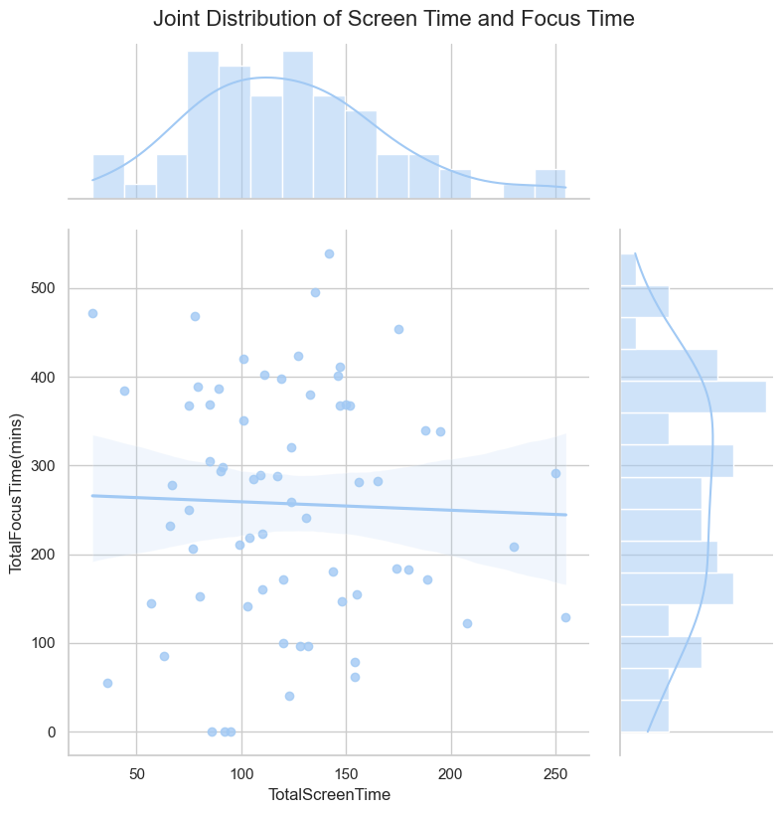
Joint Distribution of Screen Time and Focus Time
Displays the relationship between total screen time and focus time.
The regression line indicates the overall trend.
Observations: Based on the visual representation, any correlation between screen time and focus time appears to be weak or negligible. Further statistical tests (e.g., Pearson's correlation) are necessary to confirm this observation.

Slide 7
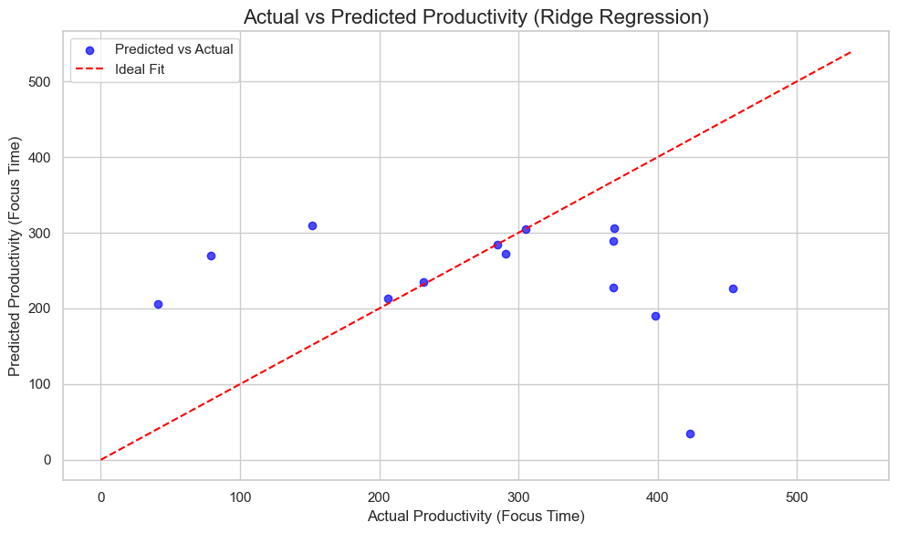
Predicting Productivity Using Ridge Regression
While the regression provides a reasonable fit for some data points, the R² value (if low) suggests that screen time and log counts alone might not be sufficient predictors of focus time. Additional features or non-linear models might improve performance.

Slide 8
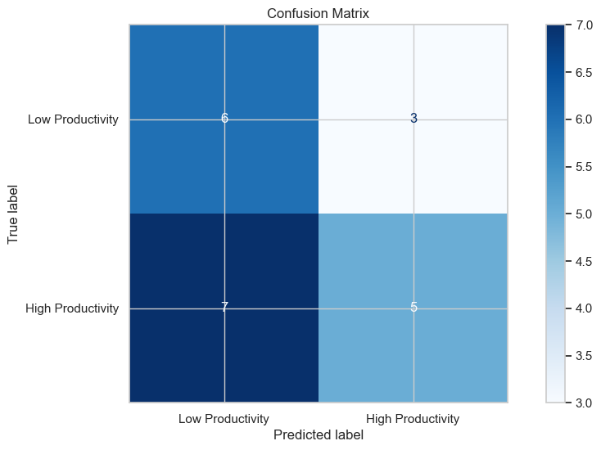
Classifying Days into High and Low Productivity
This slide illustrates the results of classifying days into "High Productivity" and "Low Productivity" using a Random Forest Classifier. The confusion matrix highlights the model's performance, showing some misclassification errors, particularly in predicting high productivity days. While the model provides a basic level of accuracy, further refinement is needed to improve its predictive capabilities.

Slide 9
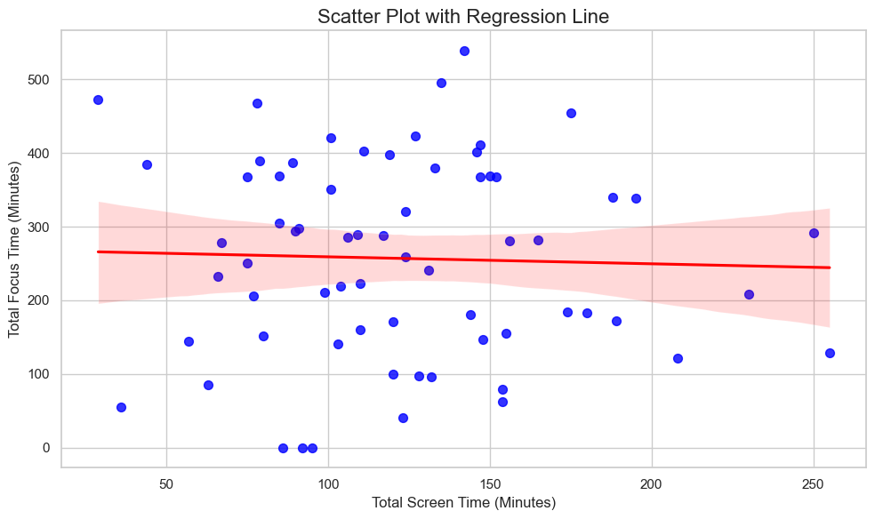
Hypothesis Testing: Screen Time vs Focus Time
Interpretation
Statistical Significance:
The data does not support a statistically significant relationship between screen time and focus time.
Hypothesis Outcome:
The hypothesis is rejected. There is no evidence to suggest that increased screen time consistently reduces focus time.
Results:
Pearson Correlation Coefficient: -0.03
P-Value: 0.7874
Statistical Significance: No significant relationship between screen time and focus time.

